Slide 1
THE SERIES
Today and coming up
Mon 14 Sep · Manhari Room
TODAY
Mon 12 Oct · Room M13
Equipping AI agents with tools
Daniel Russo-Batterham, MDAP
Working with synthetic data
Irma Mooi-Reci, School of Social and Political Sciences and QuantLab
Mon 9 Nov · Room M01
Mon 14 Dec · Manhari Room
Making AI more trustworthy with knowledge maps
Taylor Ey, Melbourne Institute
Analysing historical data with AI
David Goodman, School of Historical and Philosophical Studies
All sessions 12–1pm at Melbourne Connect, with the optional drop-in until 1.30pm.

Slide 2
Equipping LLMs with tools
Dr Daniel Russo-Batterham
Melbourne Data Analytics Platform, The University of Melbourne
daniel.russo@unimelb.edu.au

Slide 3
Session structure
The Data Landscape and AI (5 min)
Why equip LLMs with tools and how? (10 min)
MCP examples and case studies (10 min)
Activity (15 min)
Discussion and questions (10 min)

Slide 4
The Data Landscape and AI

Slide 6
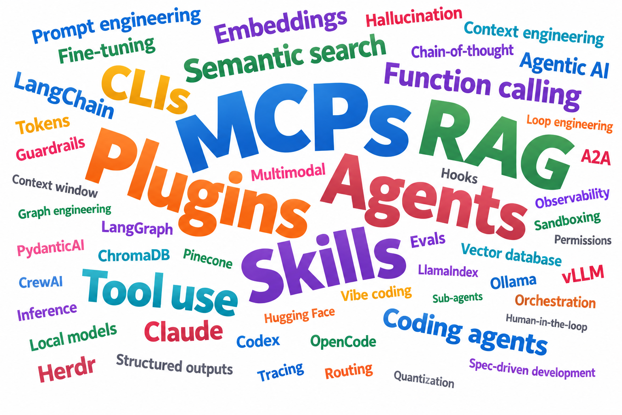

Slide 7
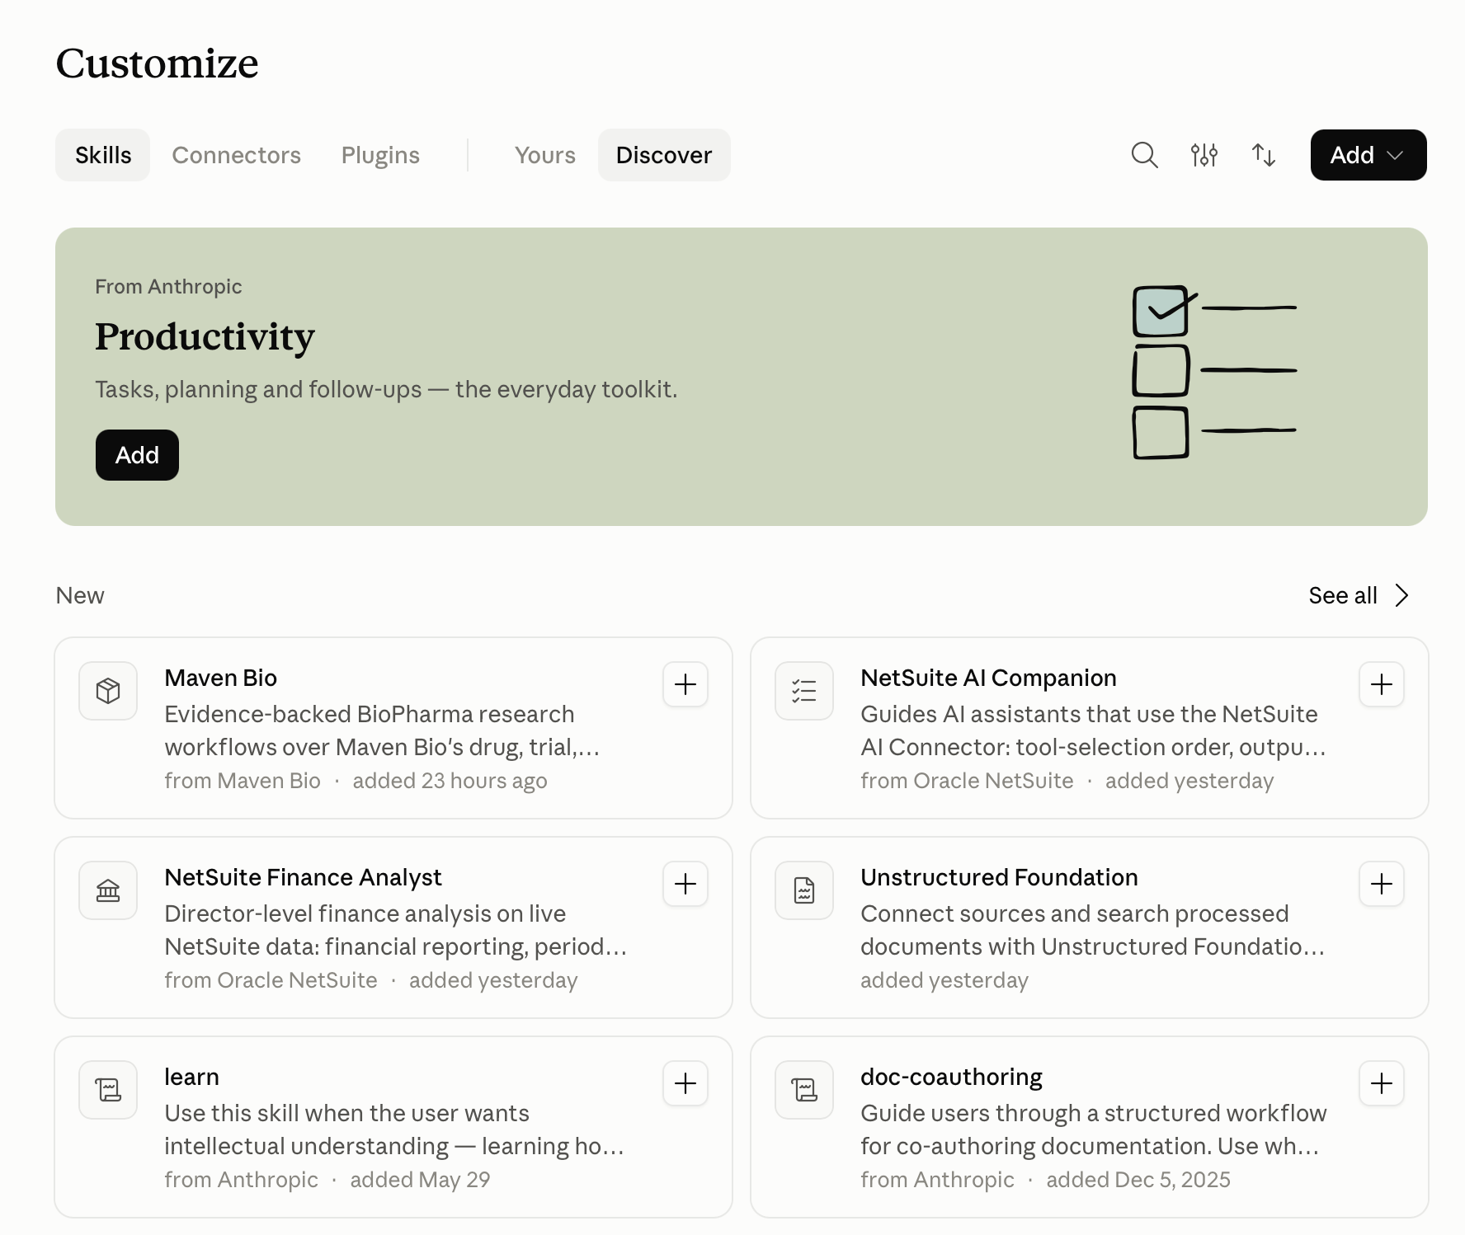
Skills, Connectors (MCPs) and Plugins

Slide 8
Why equip LLMs with tools?
Runs battle-tested code so tends to be better at specialised tasks than ad hoc LLM generations
More reliable, verifiable, and reproducible
Democratise access to non-technical audiences through Natural Language Interfaces

Slide 9
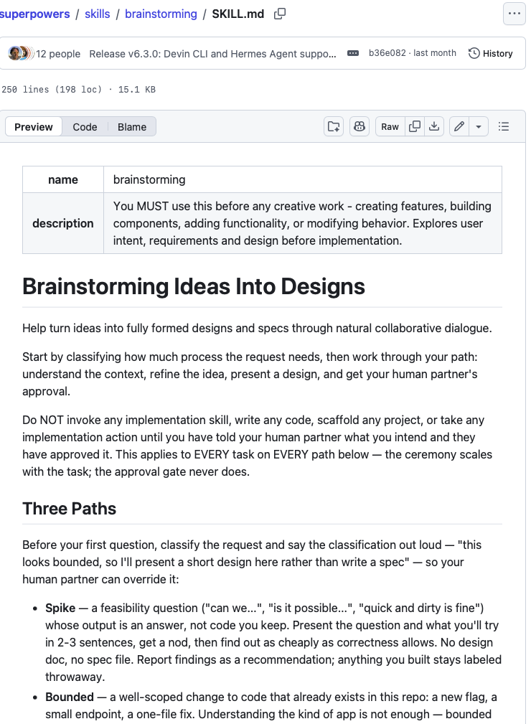
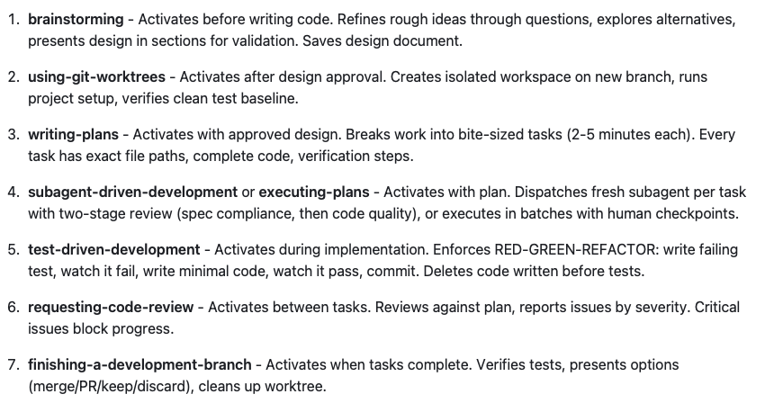
AI Skills
https://github.com/obra/superpowers

Slide 10
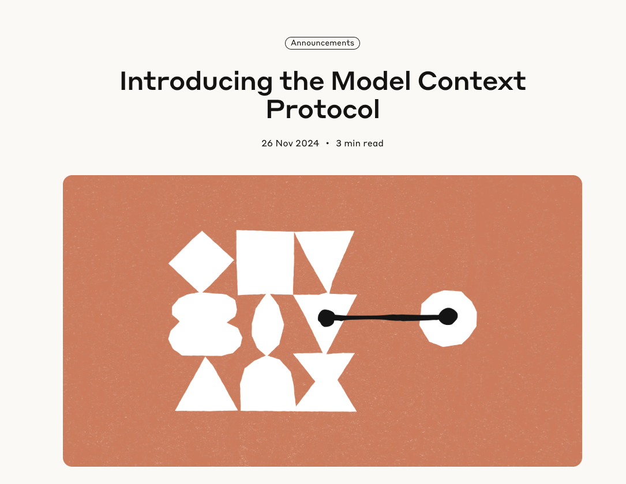
https://www.anthropic.com/news/model-context-protocol

Slide 11
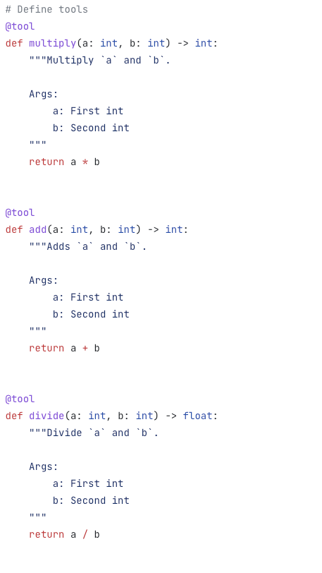
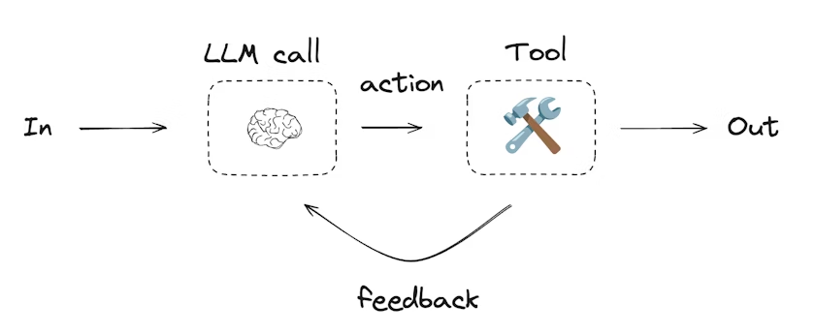
https://docs.langchain.com/oss/python/langgraph/workflows-agents

Slide 12
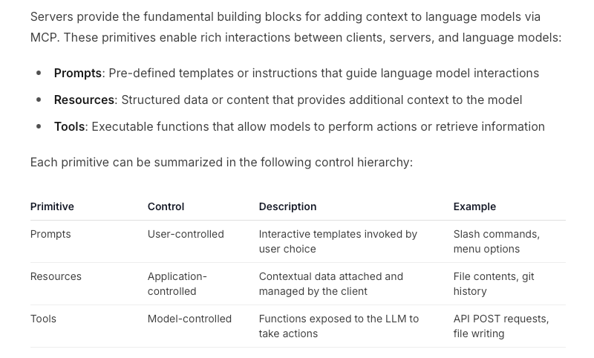
Tools
Resources
Prompts
https://modelcontextprotocol.io/specification/2025-06-18/server

Slide 13
Where can you use these tools?

Slide 14
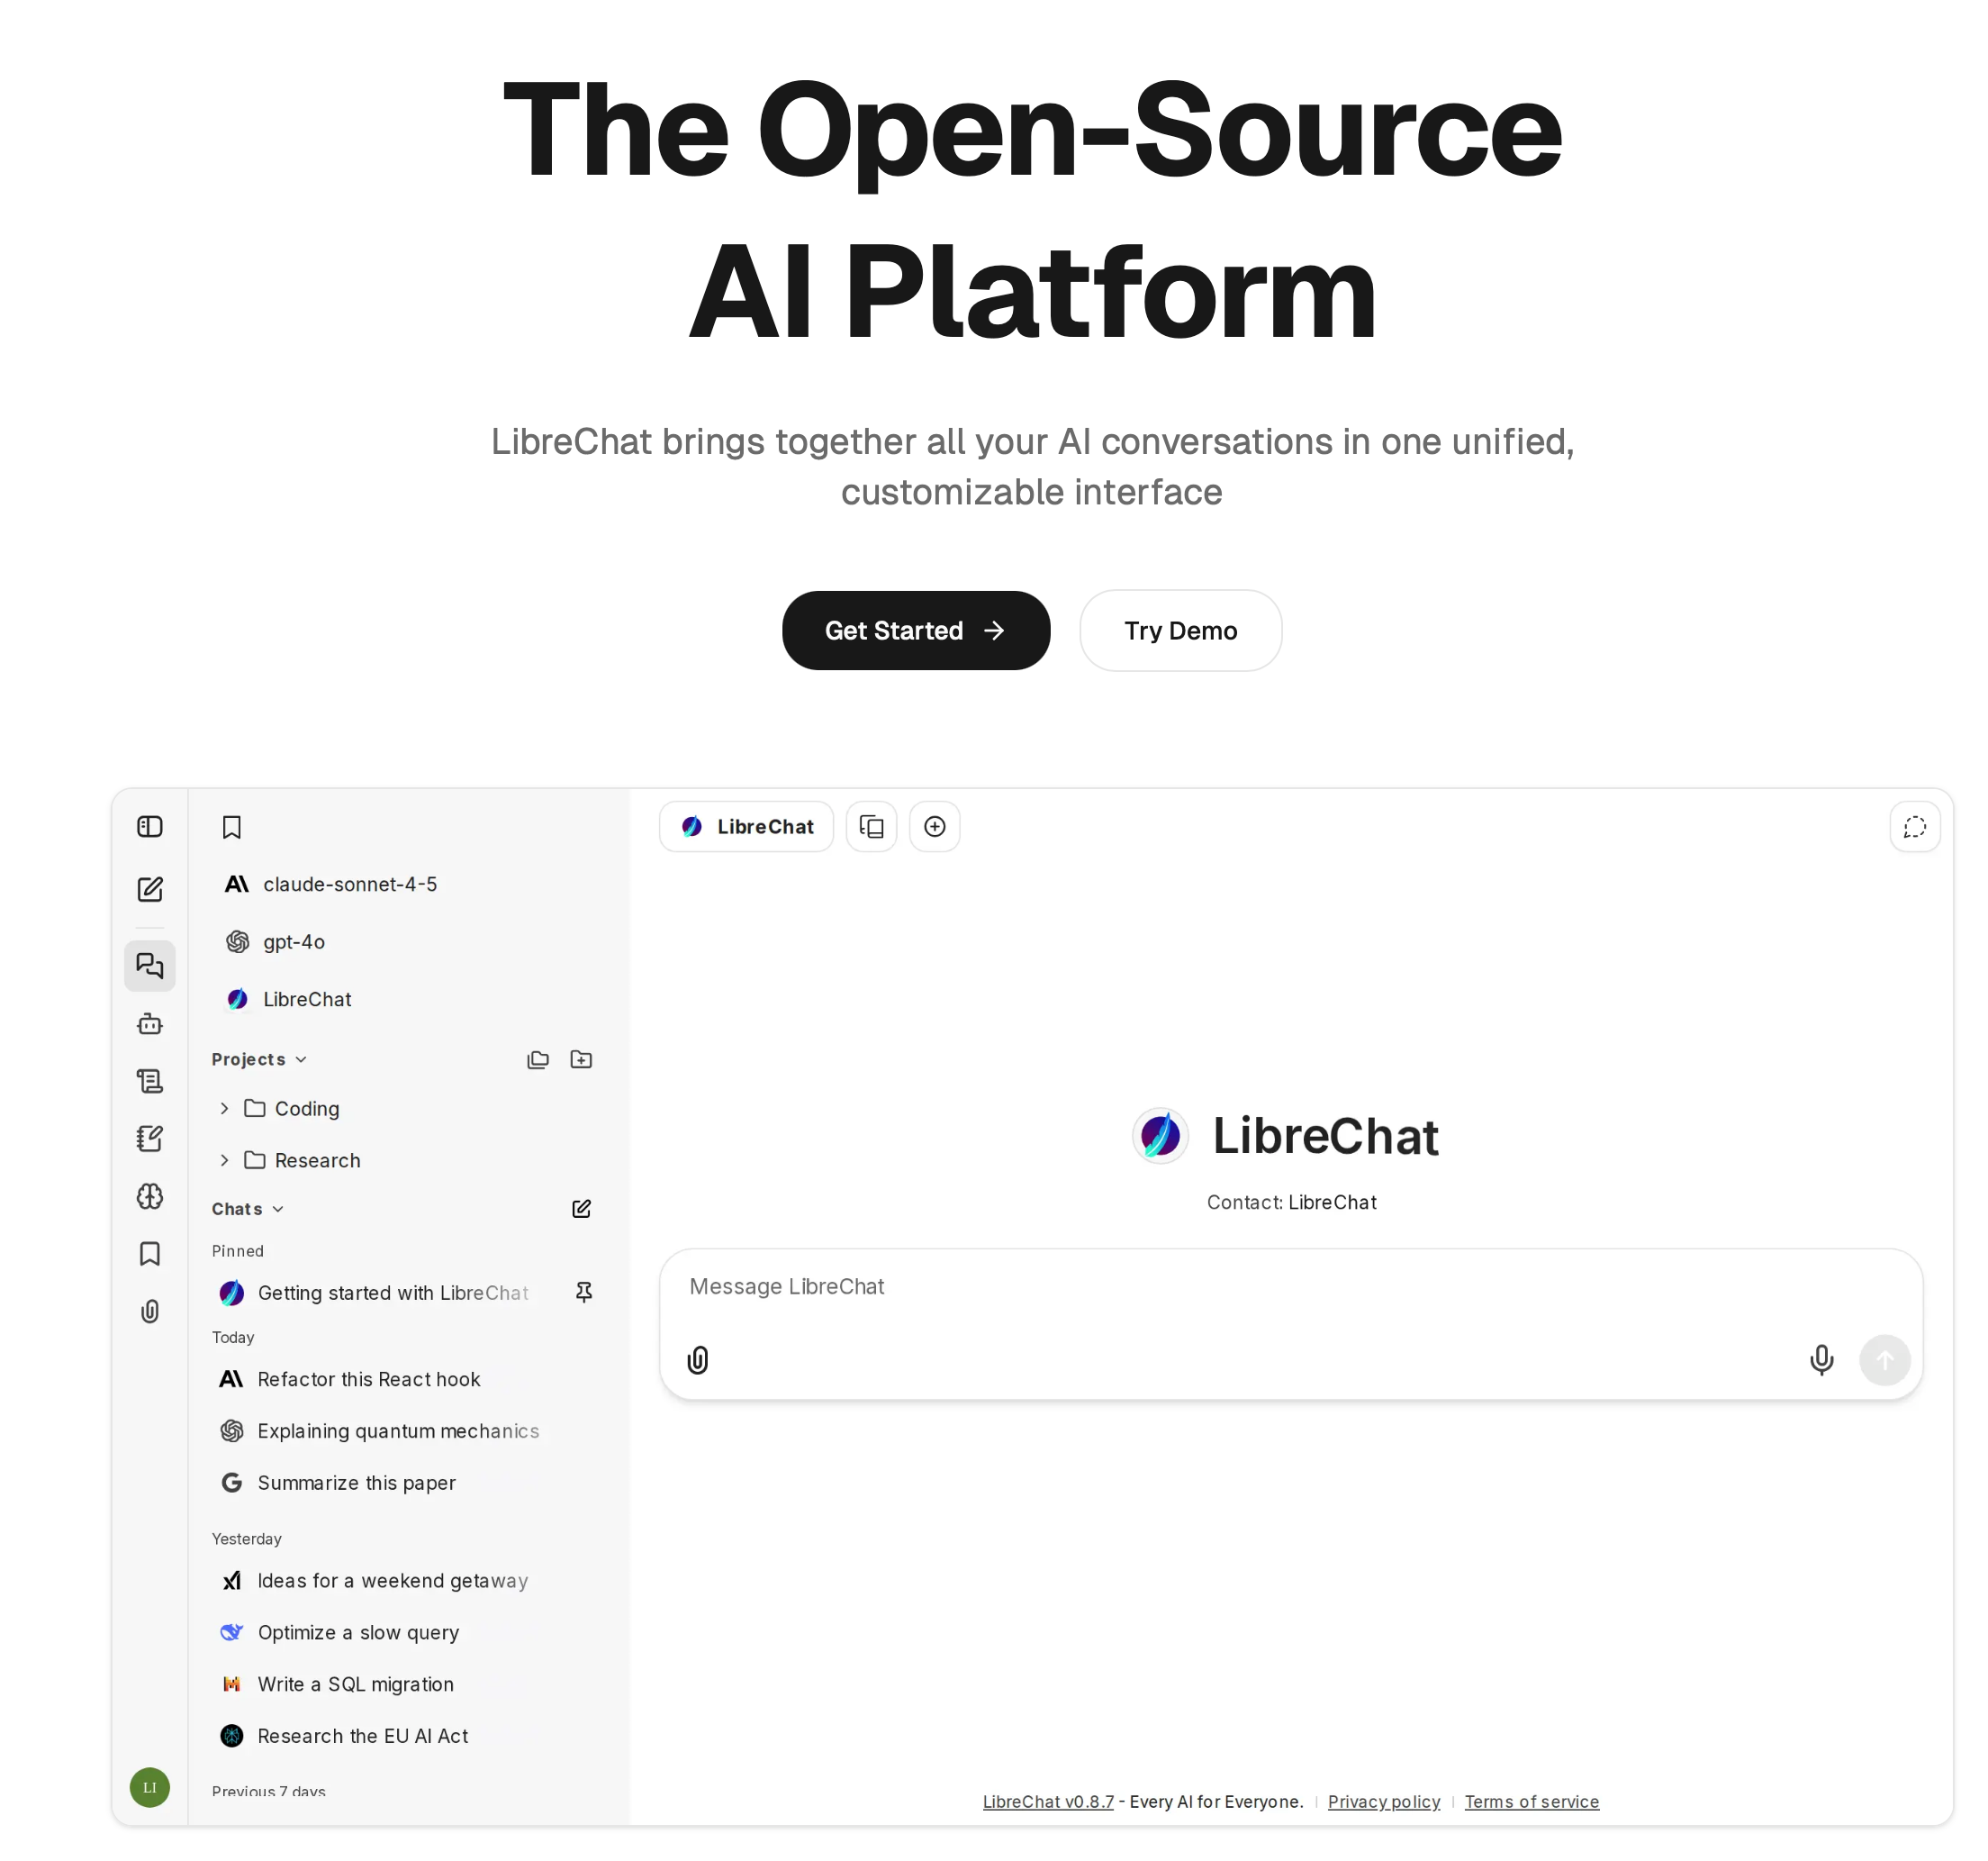
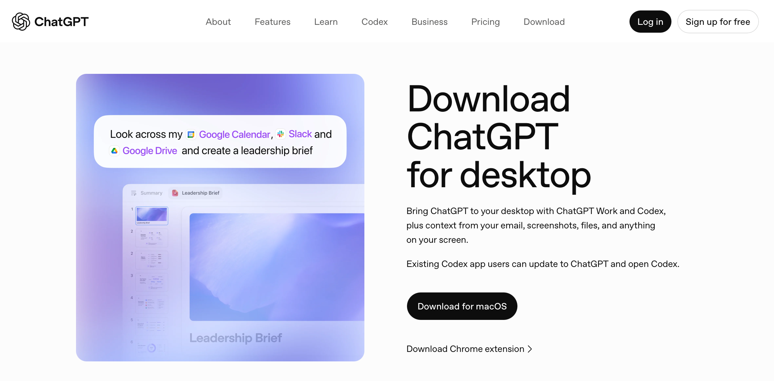
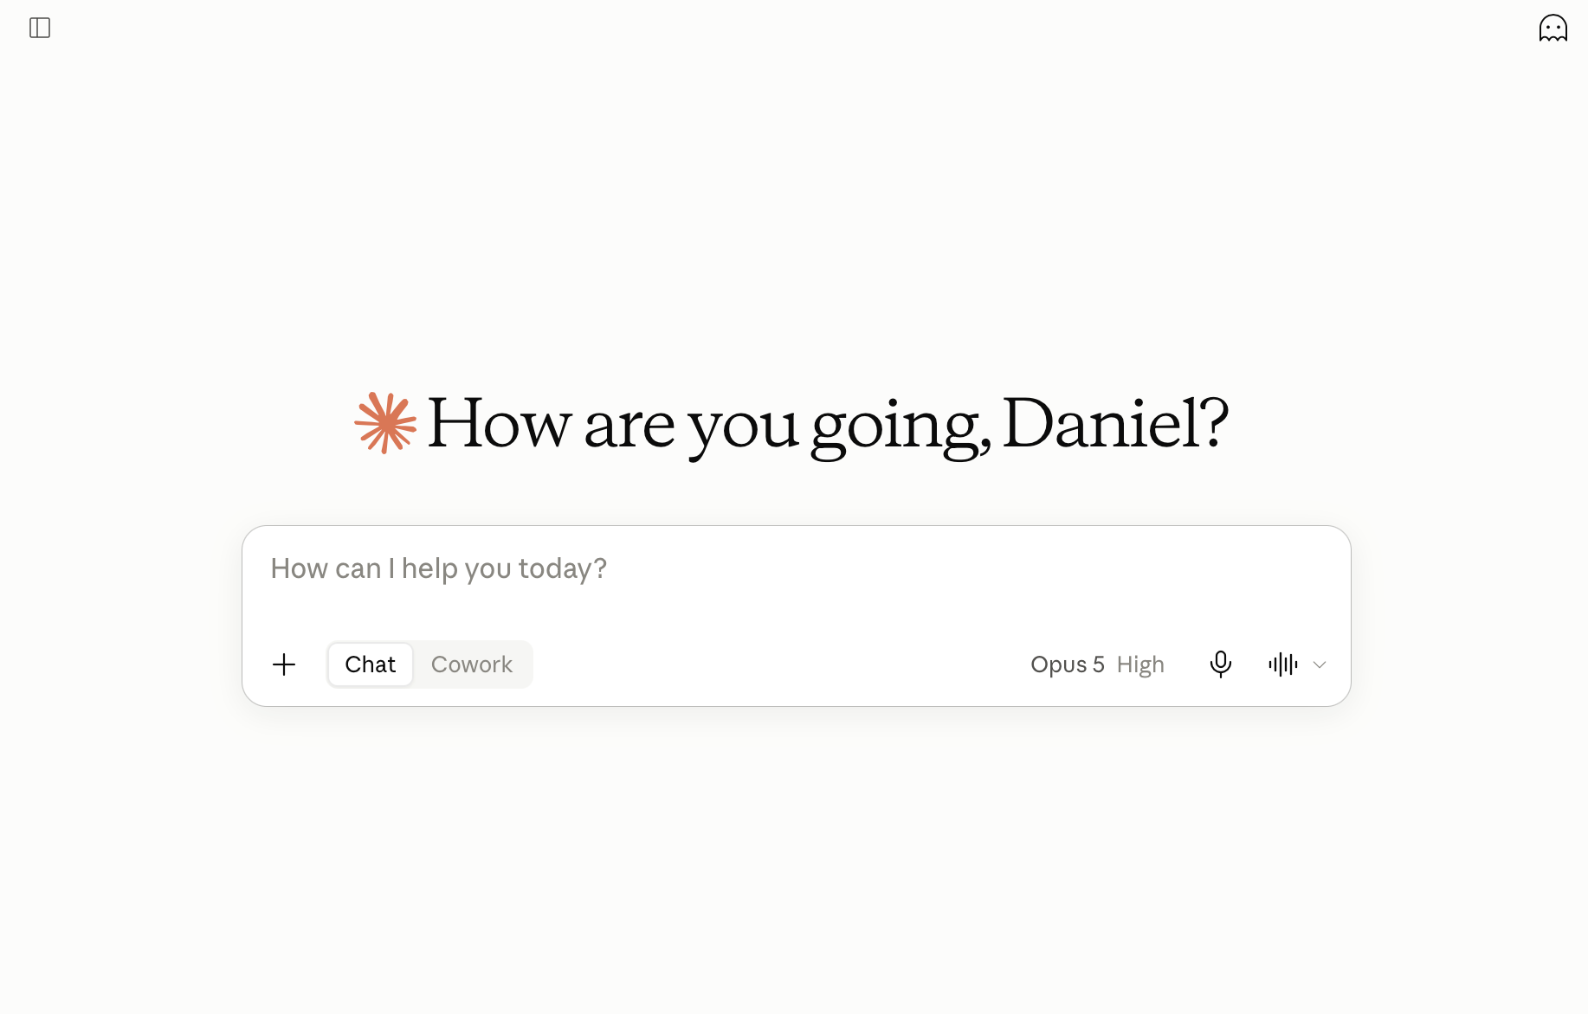
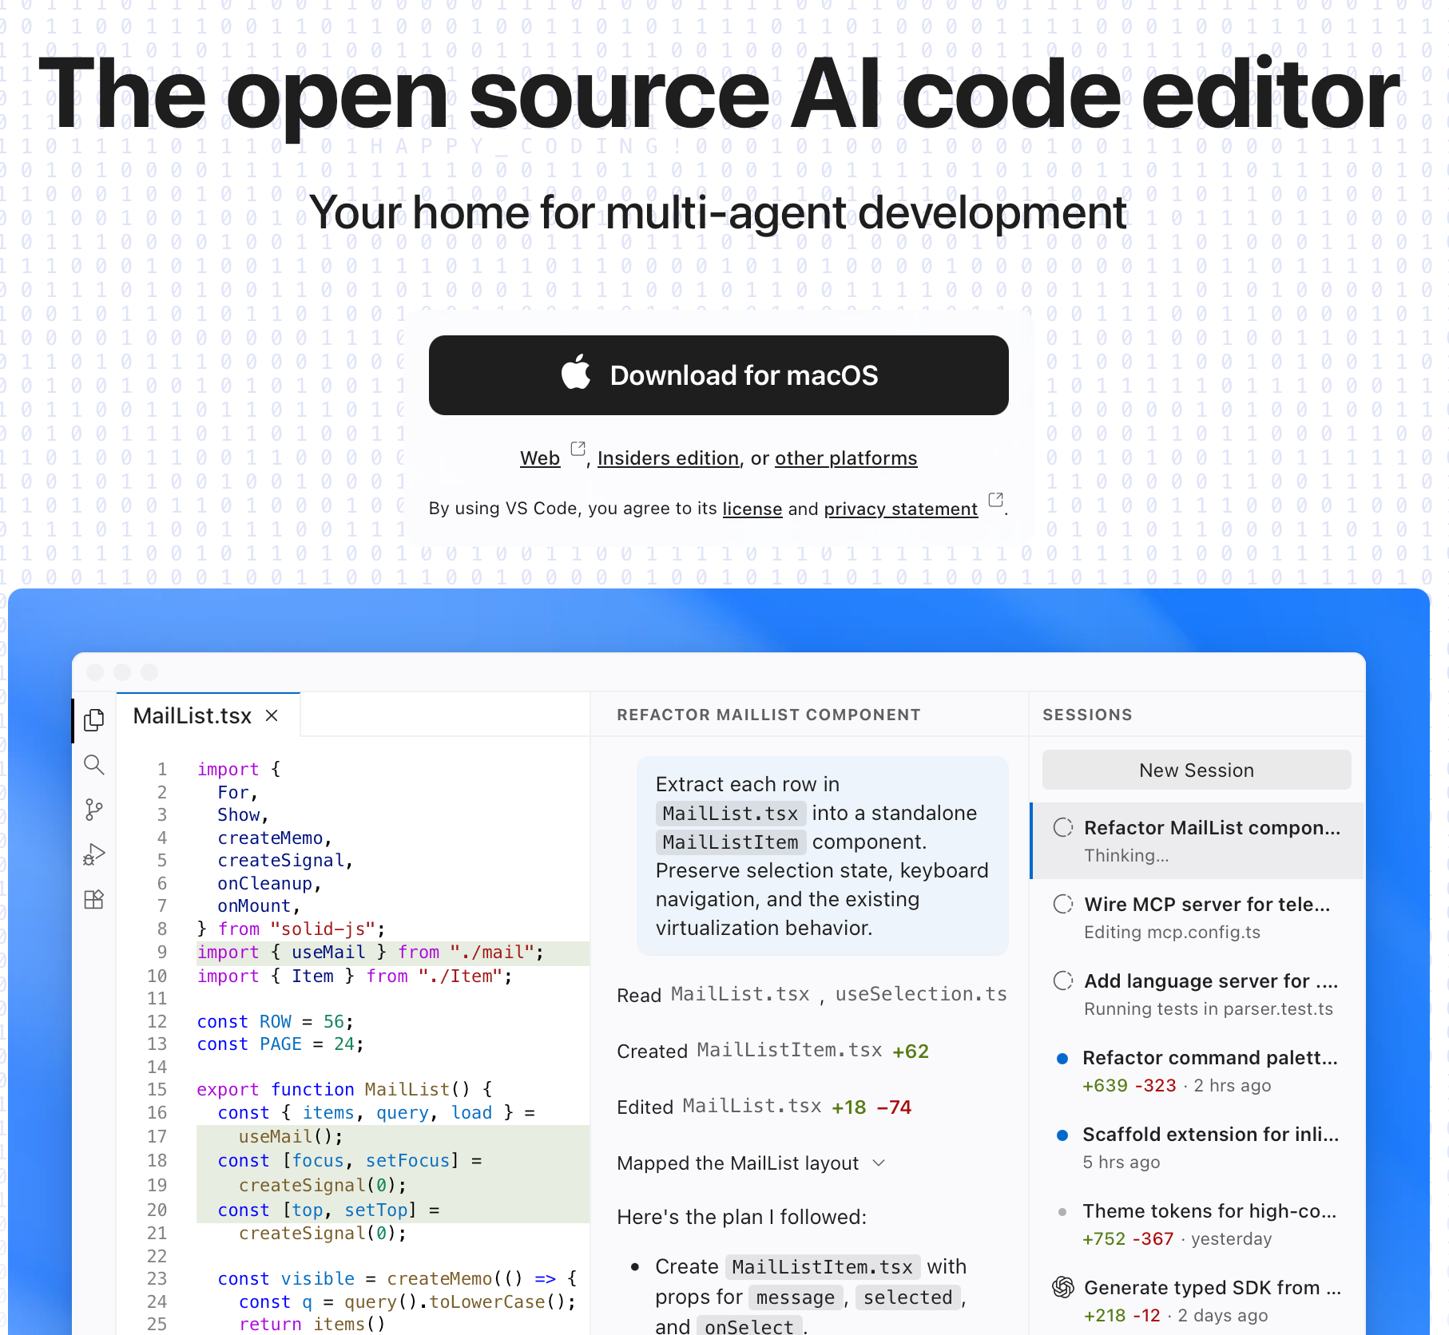
Example client applications
LibreChat · librechat.ai
ChatGPT · chatgpt.com
Claude · claude.ai, Claude Code, Desktop
VS Code · code.visualstudio.com
…and many other chat applications

Slide 15
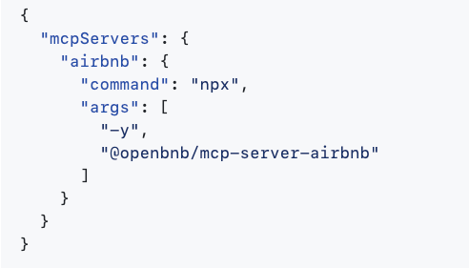
STDIO (local)
Client application runs the server
Typically uses UVX, NPM or Docker
Often allows direct operation on local files (!!)
Streamable HTTP (remote)

Slide 16
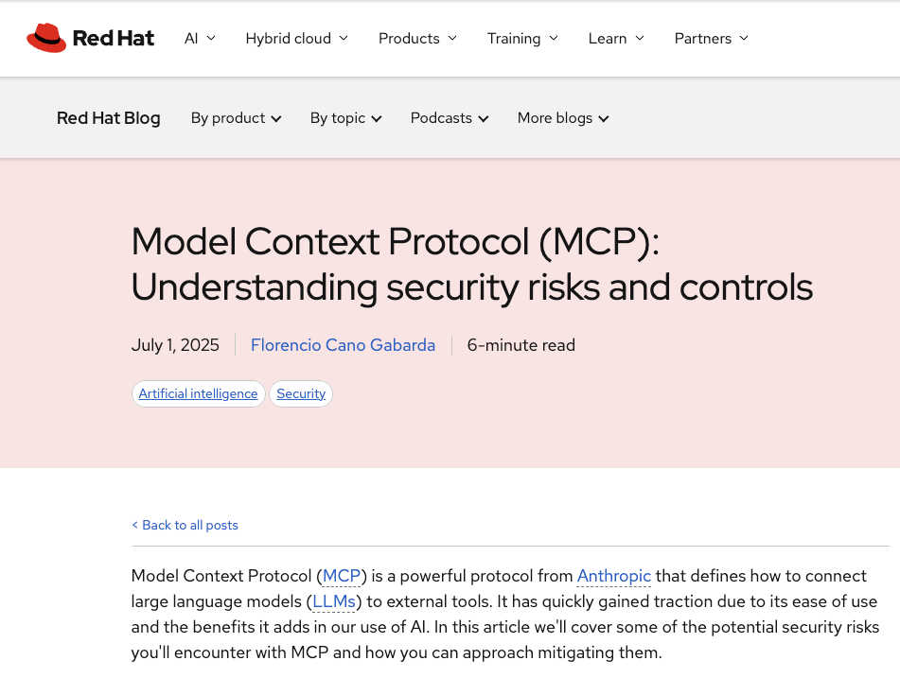
Security
https://www.redhat.com/en/blog/model-context-protocol-mcp-understanding-security-risks-and-controls

Slide 17
Some use cases

Slide 18
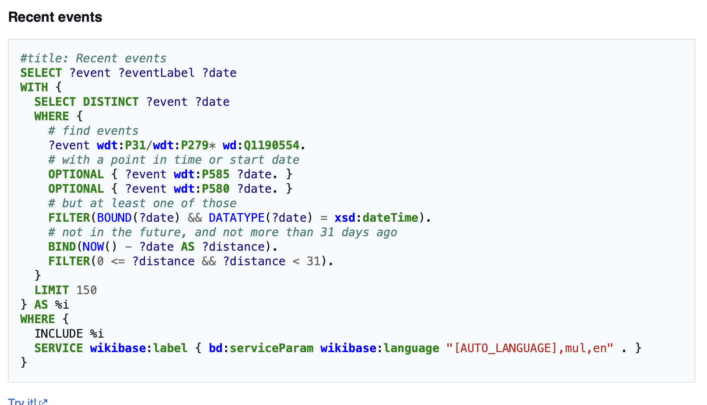
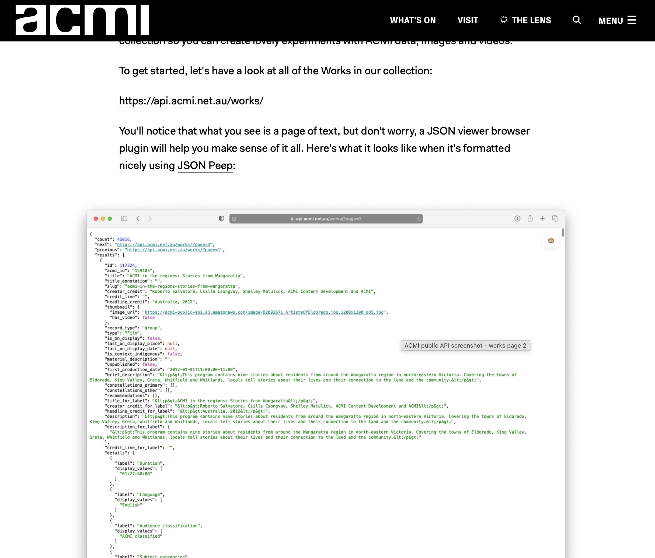
Getting data from national repositories through APIs
Wikidata query service: recent events as structured data
ACMI public collection API

Slide 19
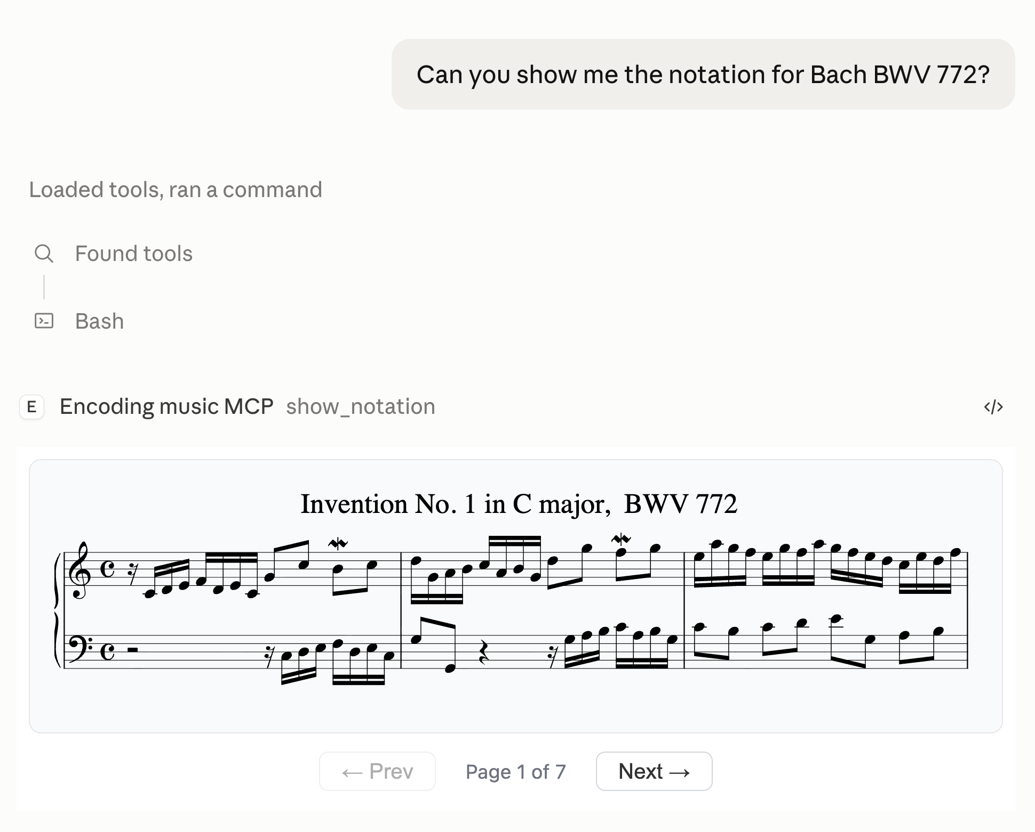
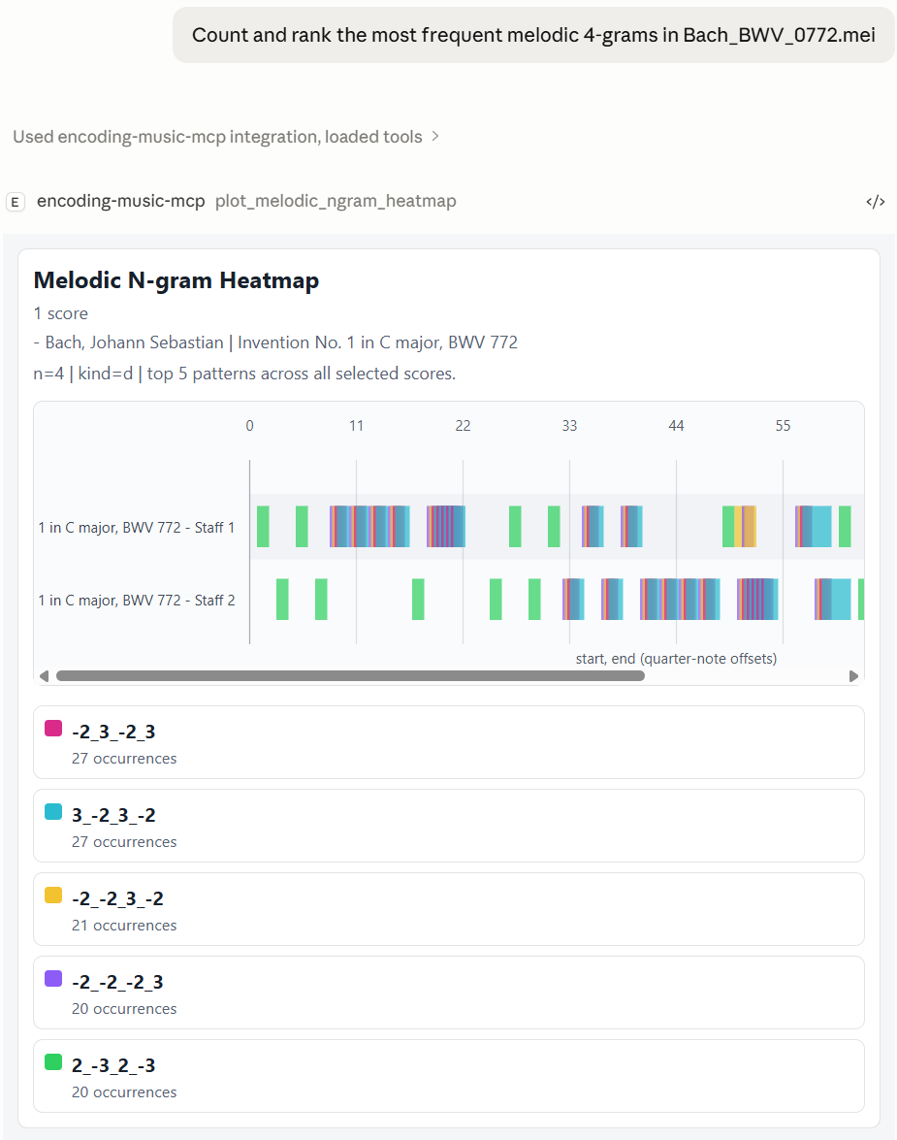
Domain-specific tools for working and exploring data

Slide 20
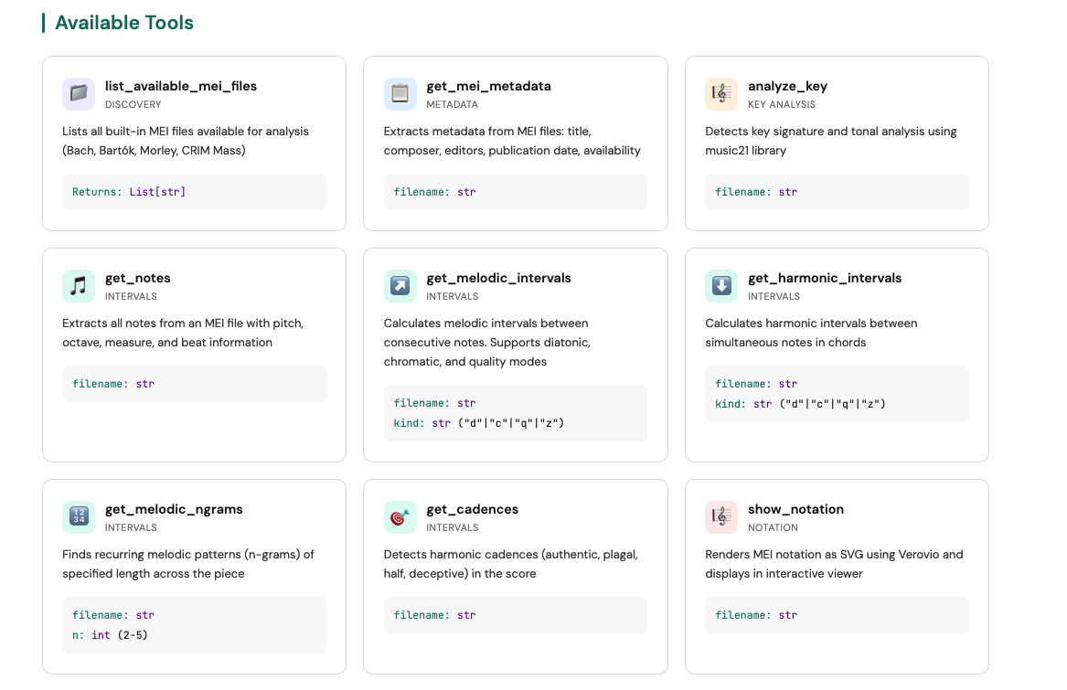

Slide 21
How does it work?

Slide 22
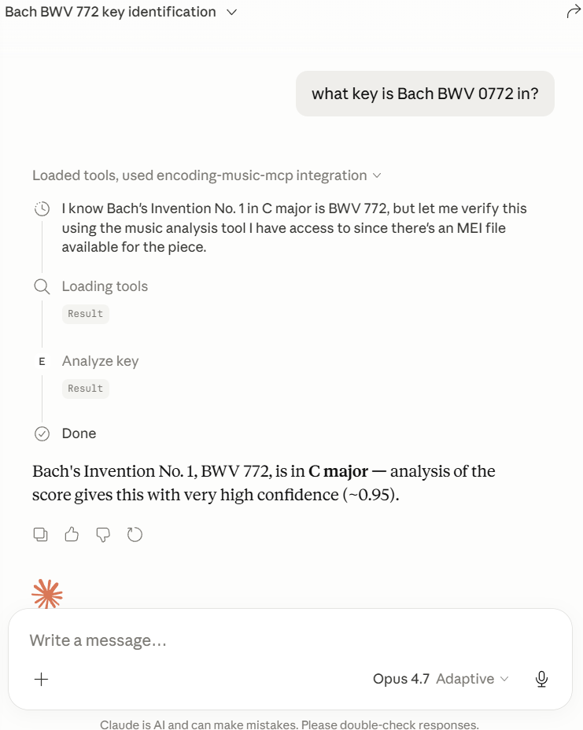
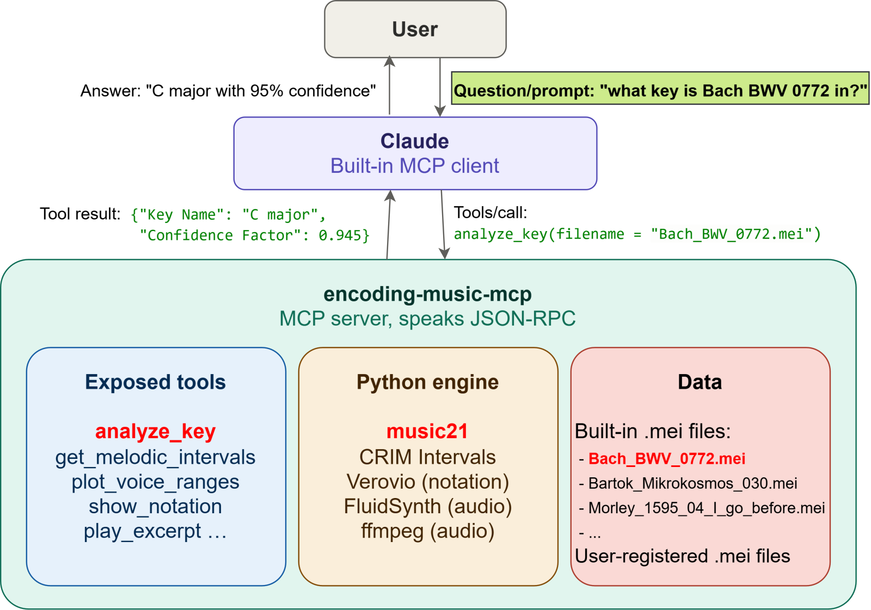
User asks questions in natural language

Slide 23
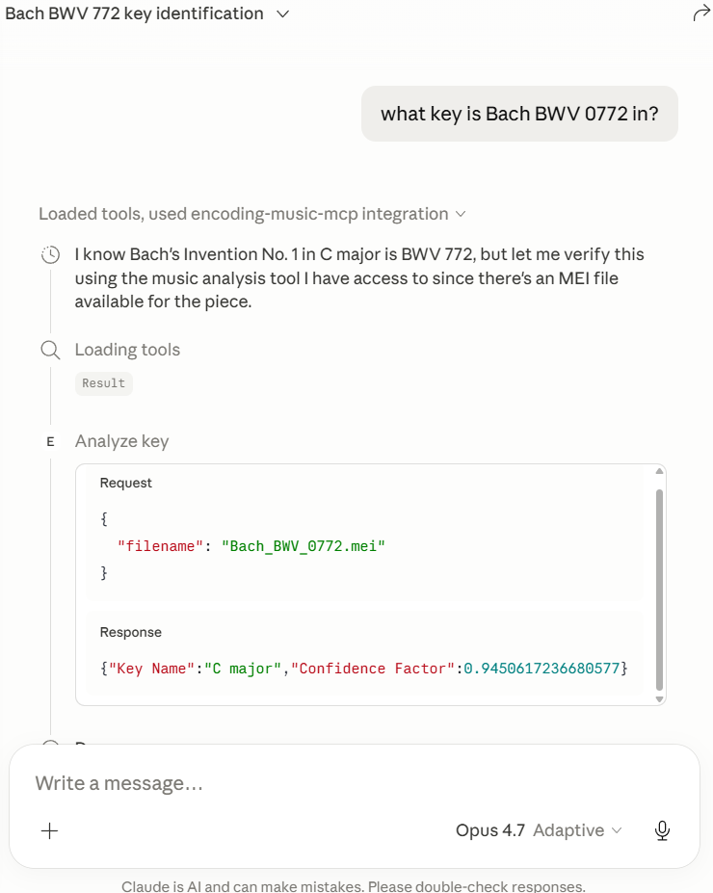
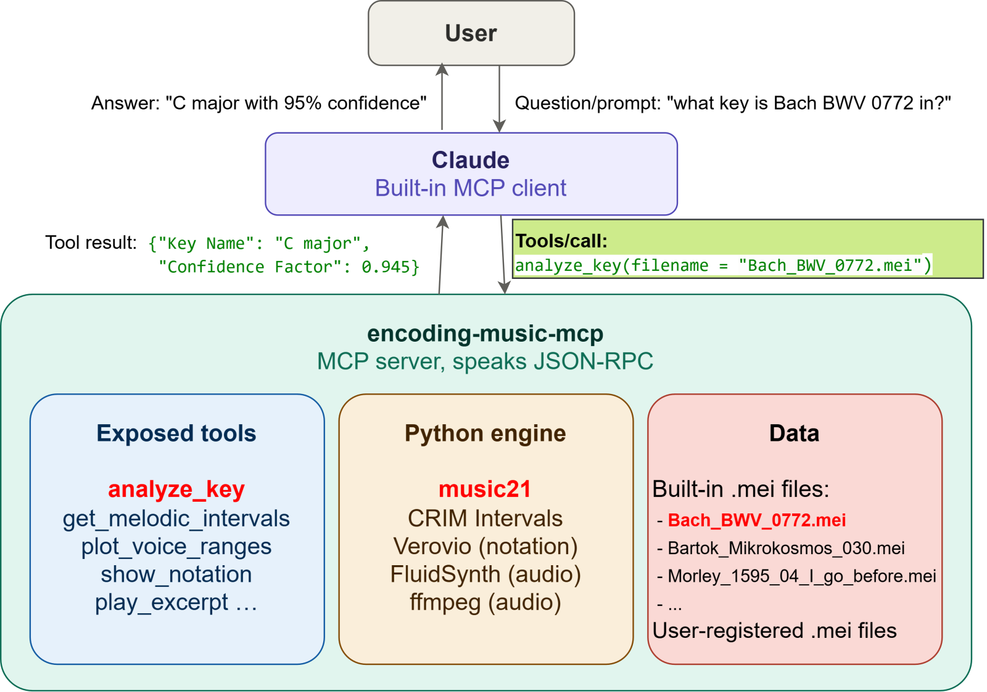
MCP client decides which tool(s) to call

Slide 24
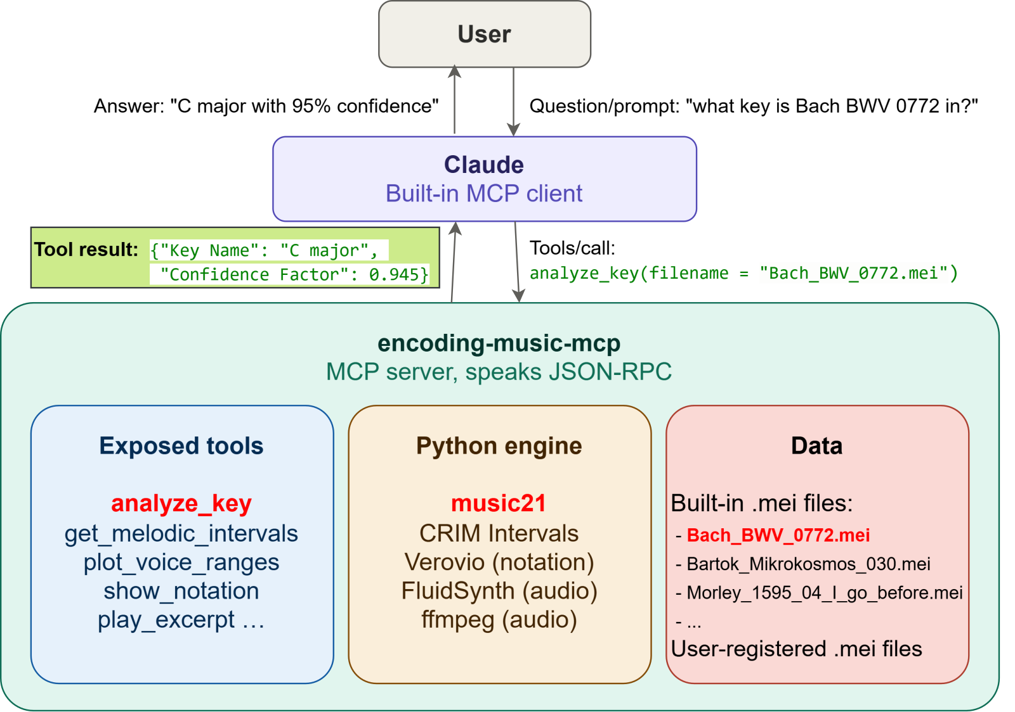
MCP server returns the tool result

Slide 25
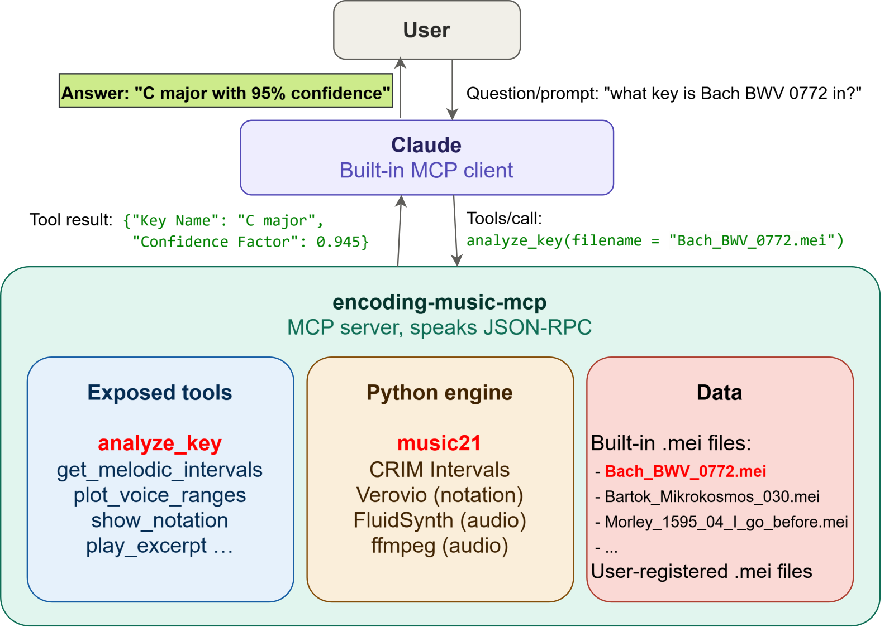


MCP client interprets the result

Slide 26
Hansard case study

Slide 27
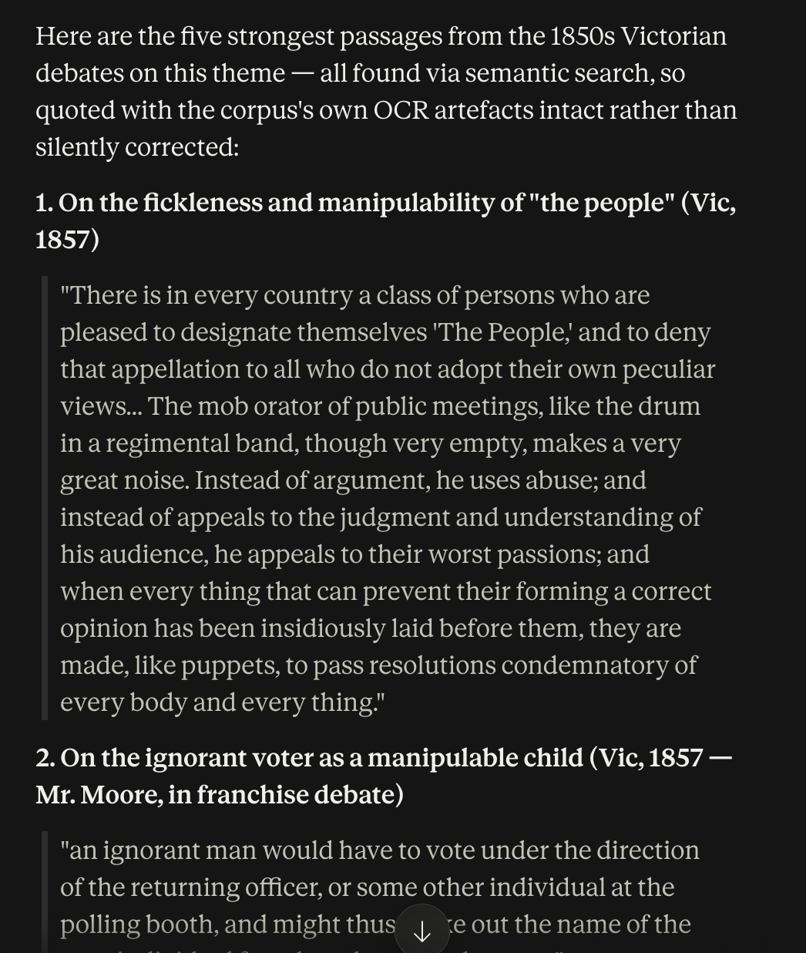
Semantic search of the database in Claude Desktop via MCP
Prompt: Find me the top 5 quotes from the 1850s in Victoria about democracy as a problem or danger. This might relate to perceptions of the fickleness of 'the people', their irrationality, lack of education, or the way the propertyless could not be trusted to govern responsibly.

Slide 28
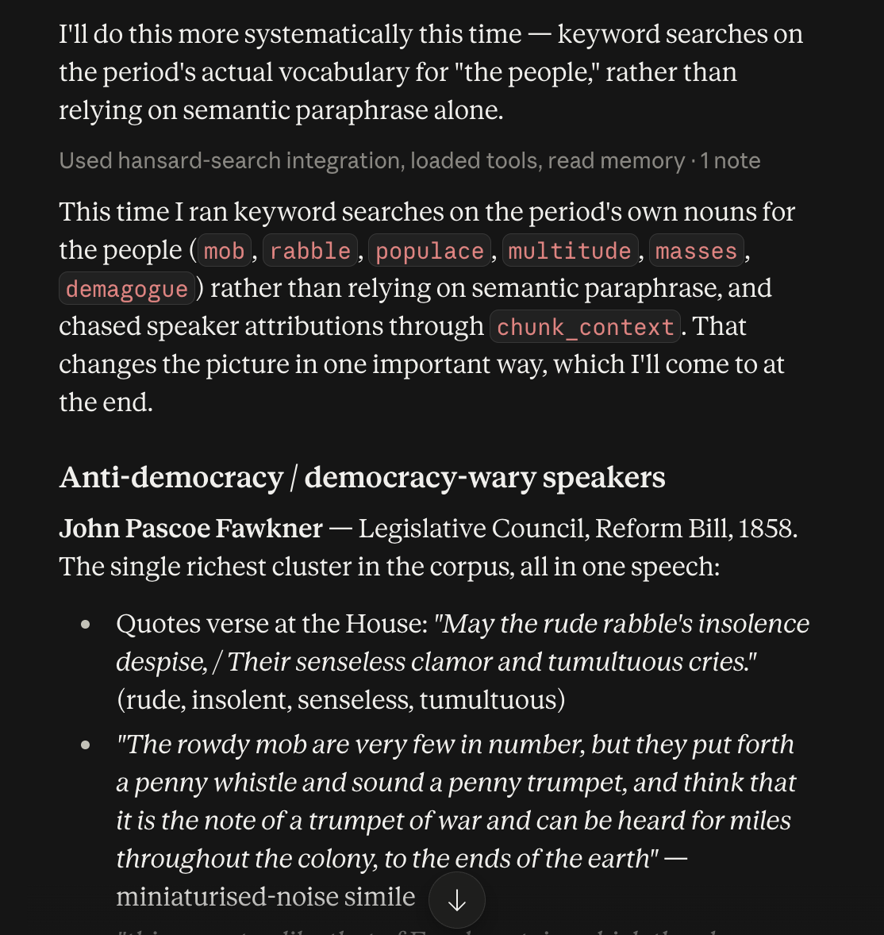
How democracy was discussed in parliament in 1850s Victoria
I asked Sonnet: ‘Reverting to the Victorian discussion of democracy through the 1850s - what adjectives, metaphors or similes are used to describe "the people" in these debates? Group by pro and anti democracy speakers.’ The answer was very revealing. It pointed to comments about the animality of the mob; ordinary people as puppets able to be manipulated by the rich and powerful; the childishness of the ignorant and uneducated; democracy itself viewed as an organic and threatening force. The people were cast as "ignorant," "besotted," "degraded," "rash," "speculative," "unsettled" (of goldfields population), "incendiary" (of adventurer-politicians), "presumptuous," "insidious.”
On the other (pro-democracy) side, it found, the language was much less vivid and metaphoric. Ordinary and humble people had common sense, respect for property and the law, conservative instincts, they were industrious and intelligent.
Then I gave the same prompt to Opus, the higher model. It sliced the material in a different way – by speaker, usefully, helping me see the ways certain speakers ran one or other of these arguments.

Slide 29
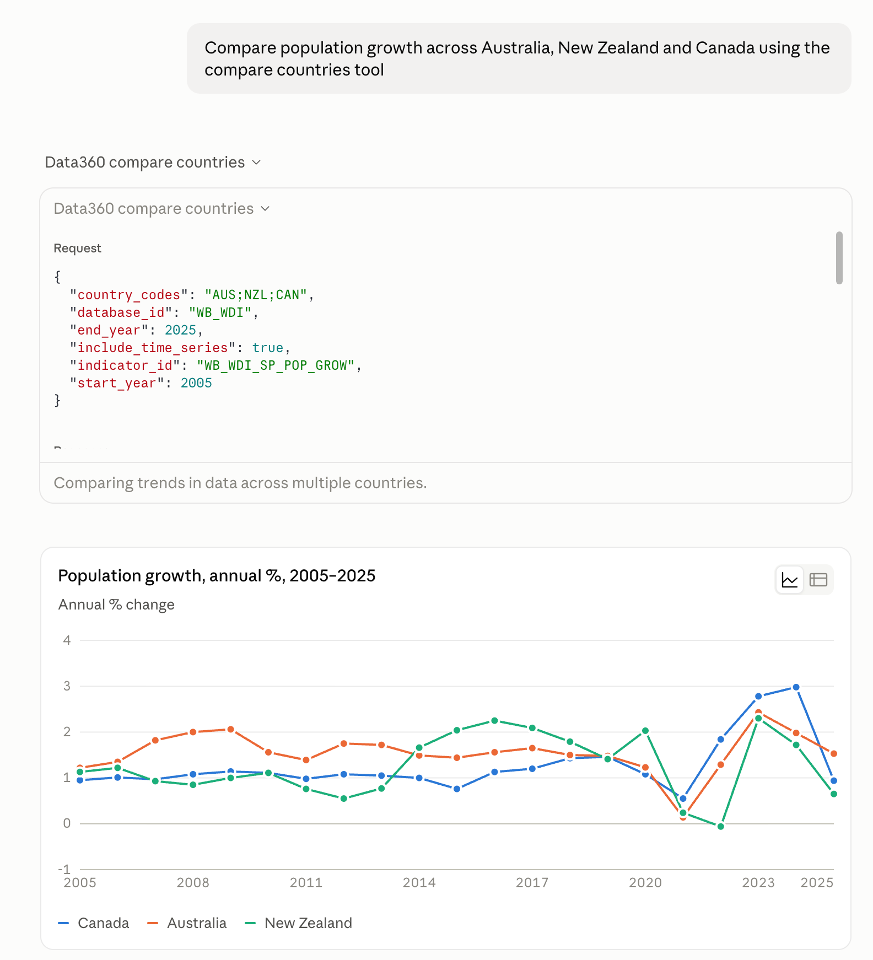
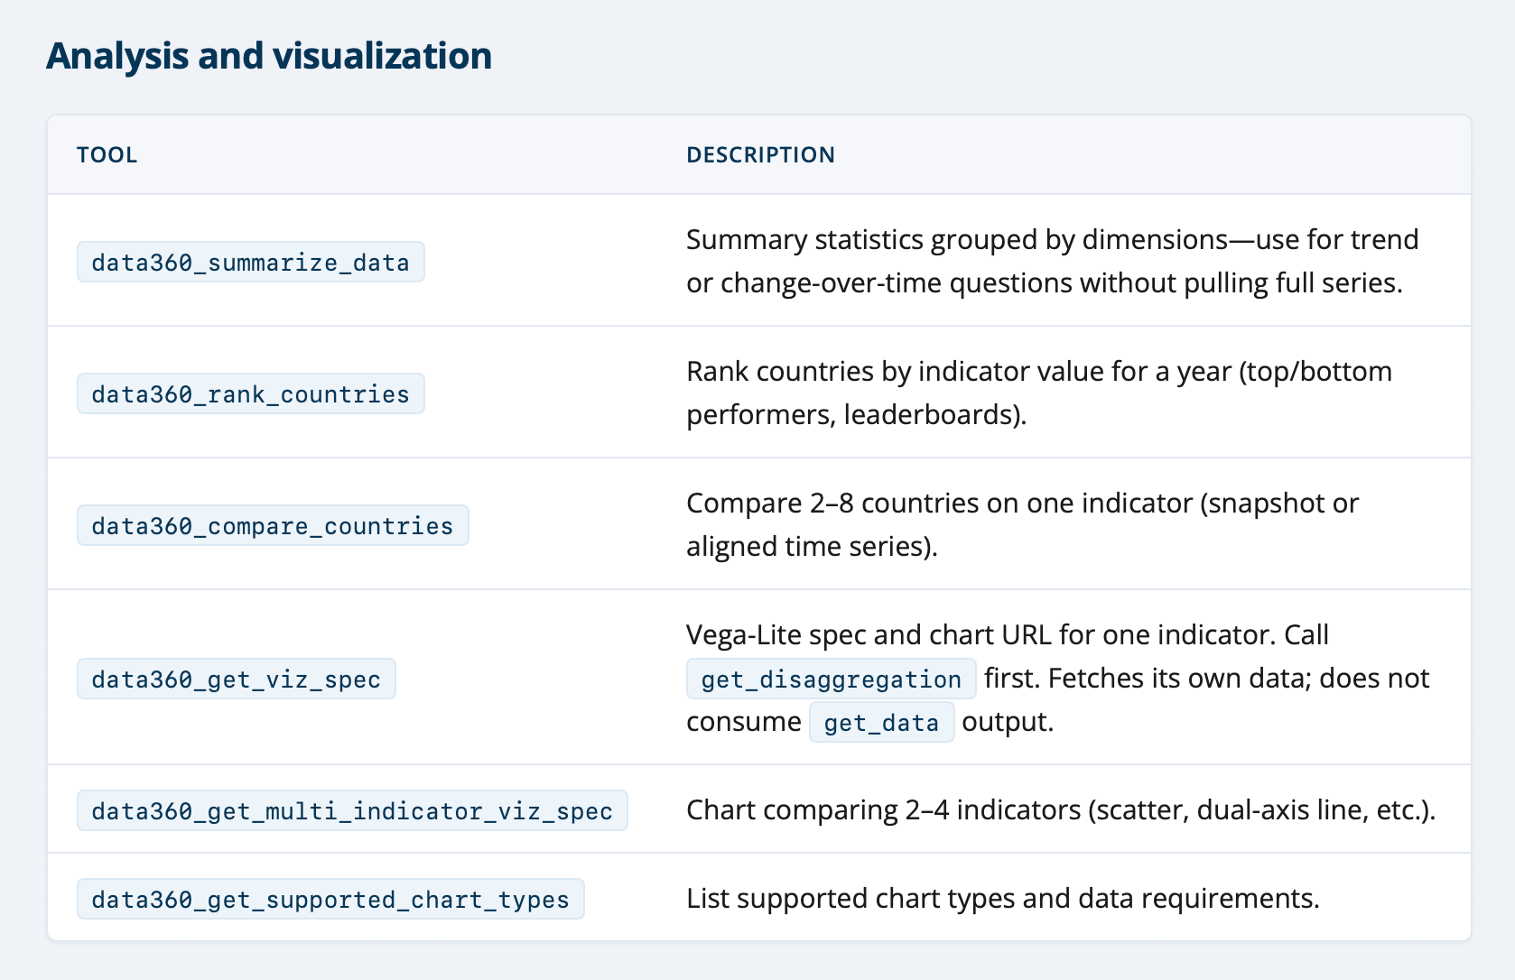
World Bank Data360

Slide 30
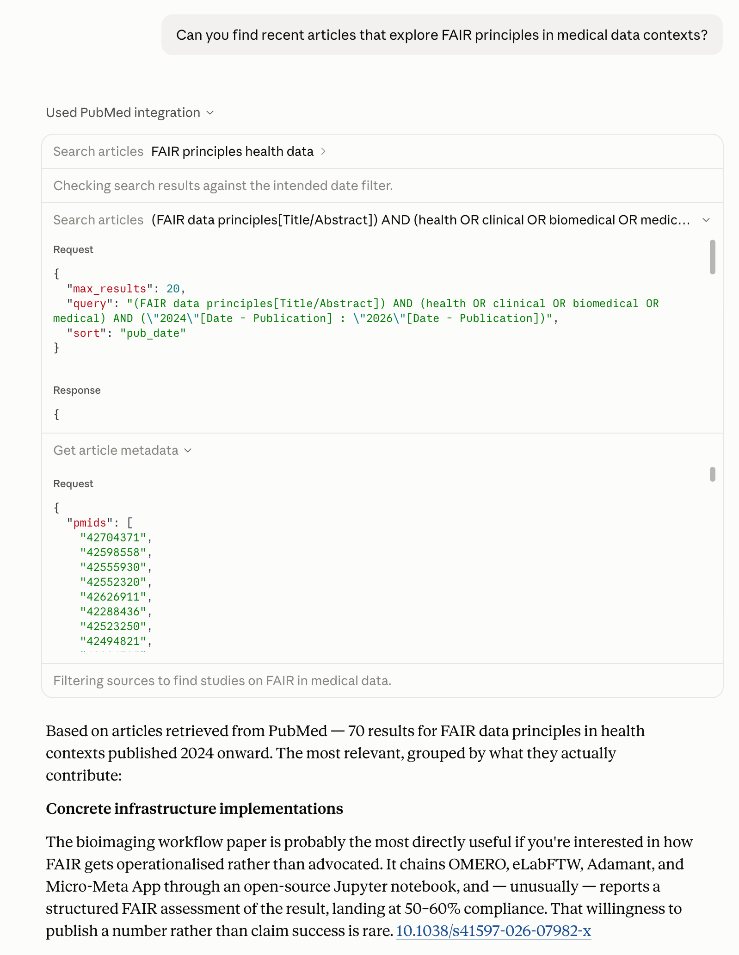
PubMed
Biomedical literature search, in two steps: a search returns article IDs, a second call fetches the detail.
Anthropic itself provides a set of example use cases as part of its training: https://academy.claude.com/tutorials/using-the-pubmed-connector-in-claude

Slide 31

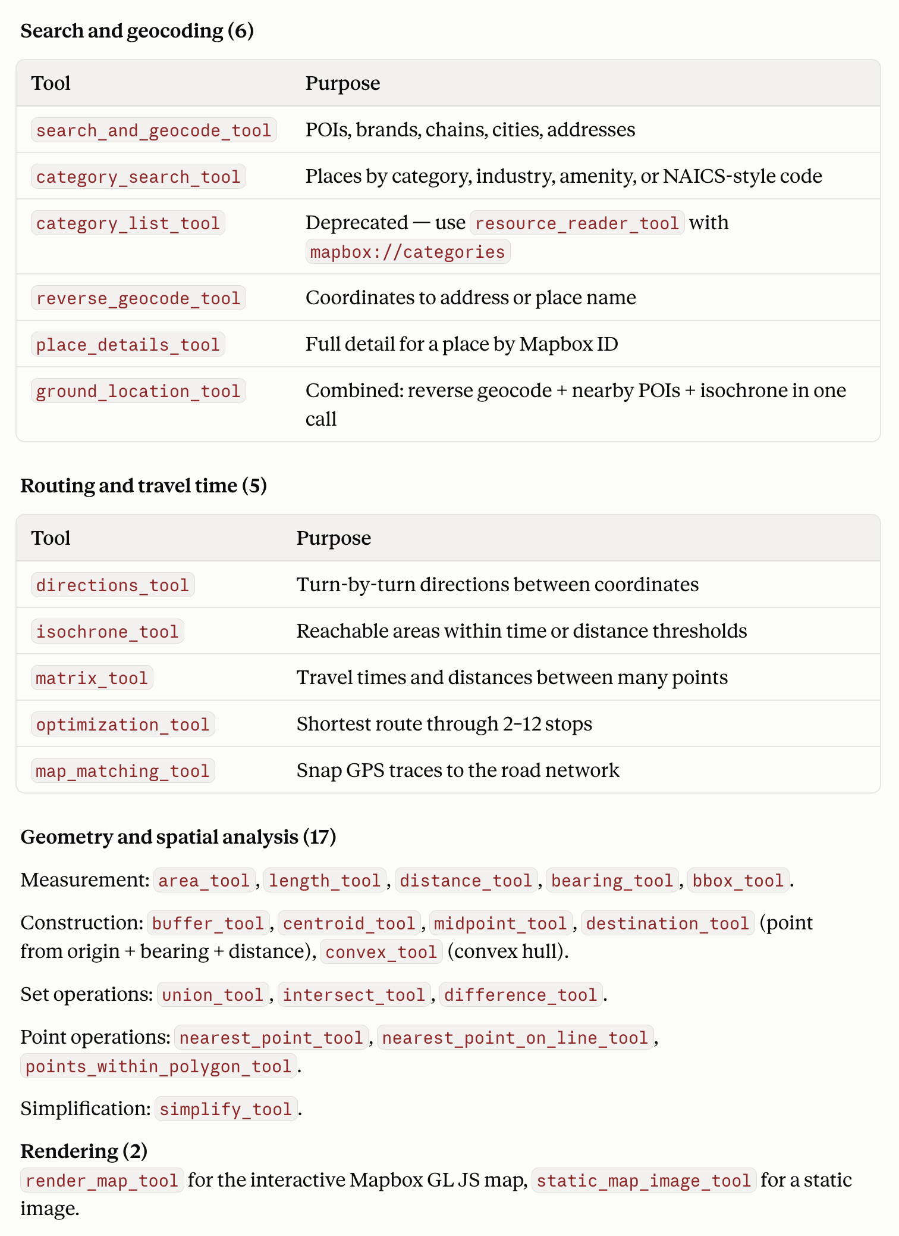
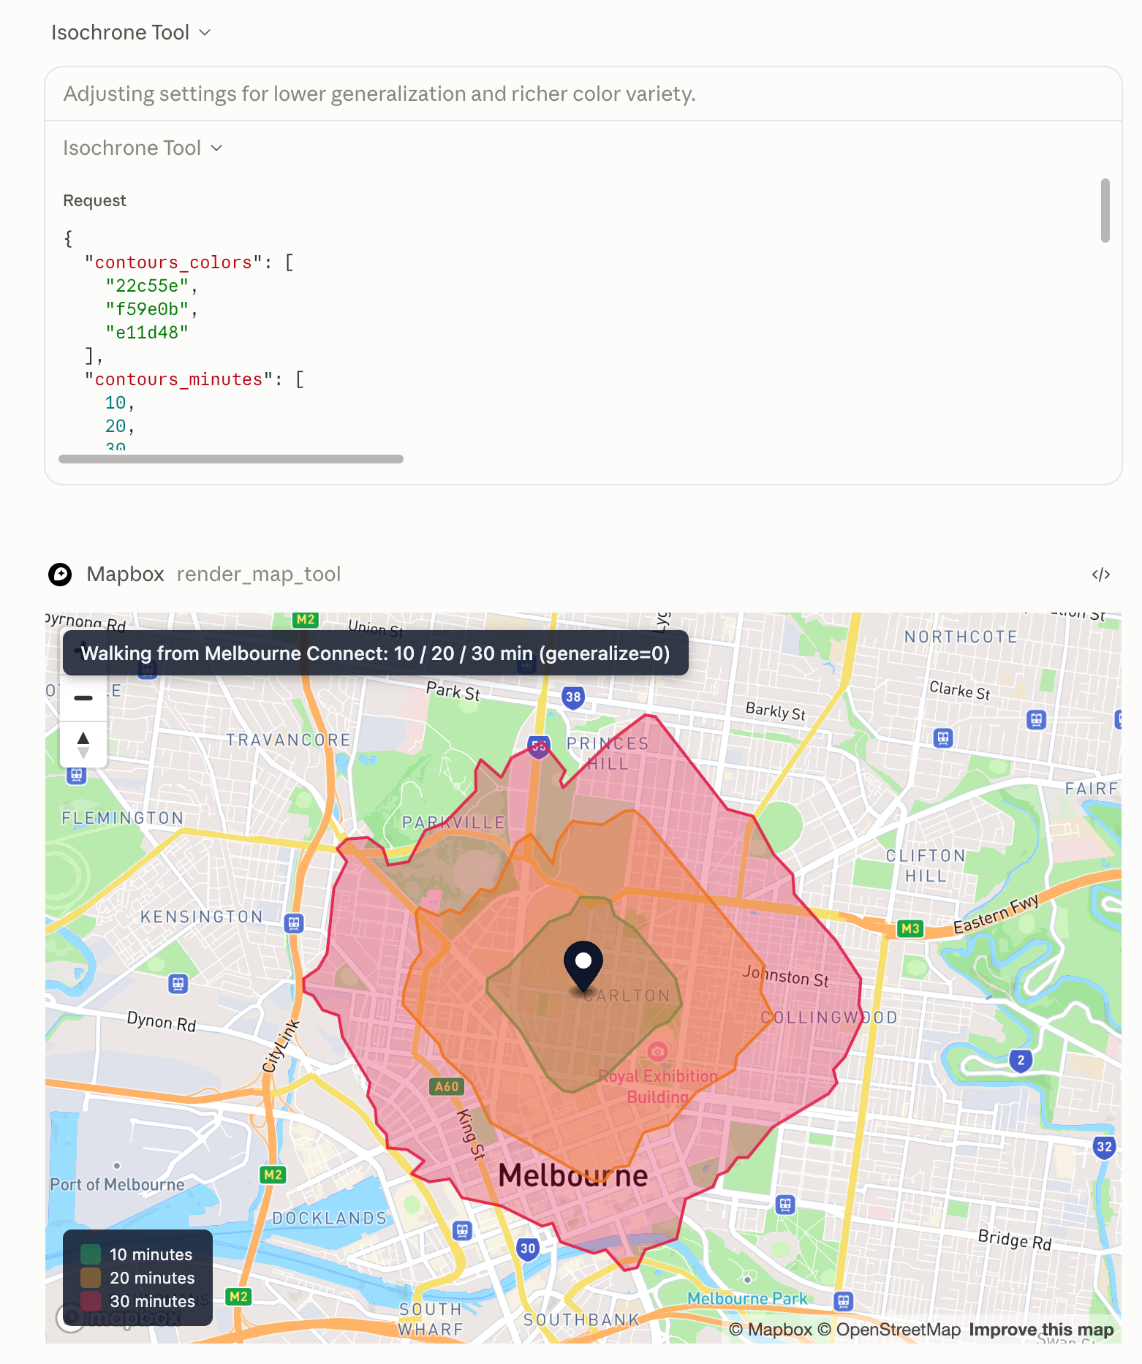
Mapbox

Slide 32
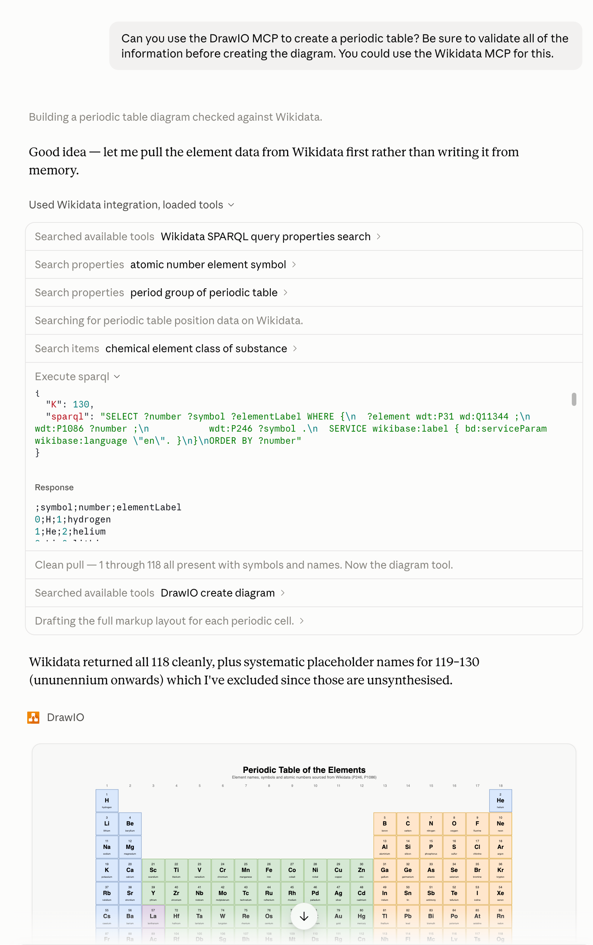
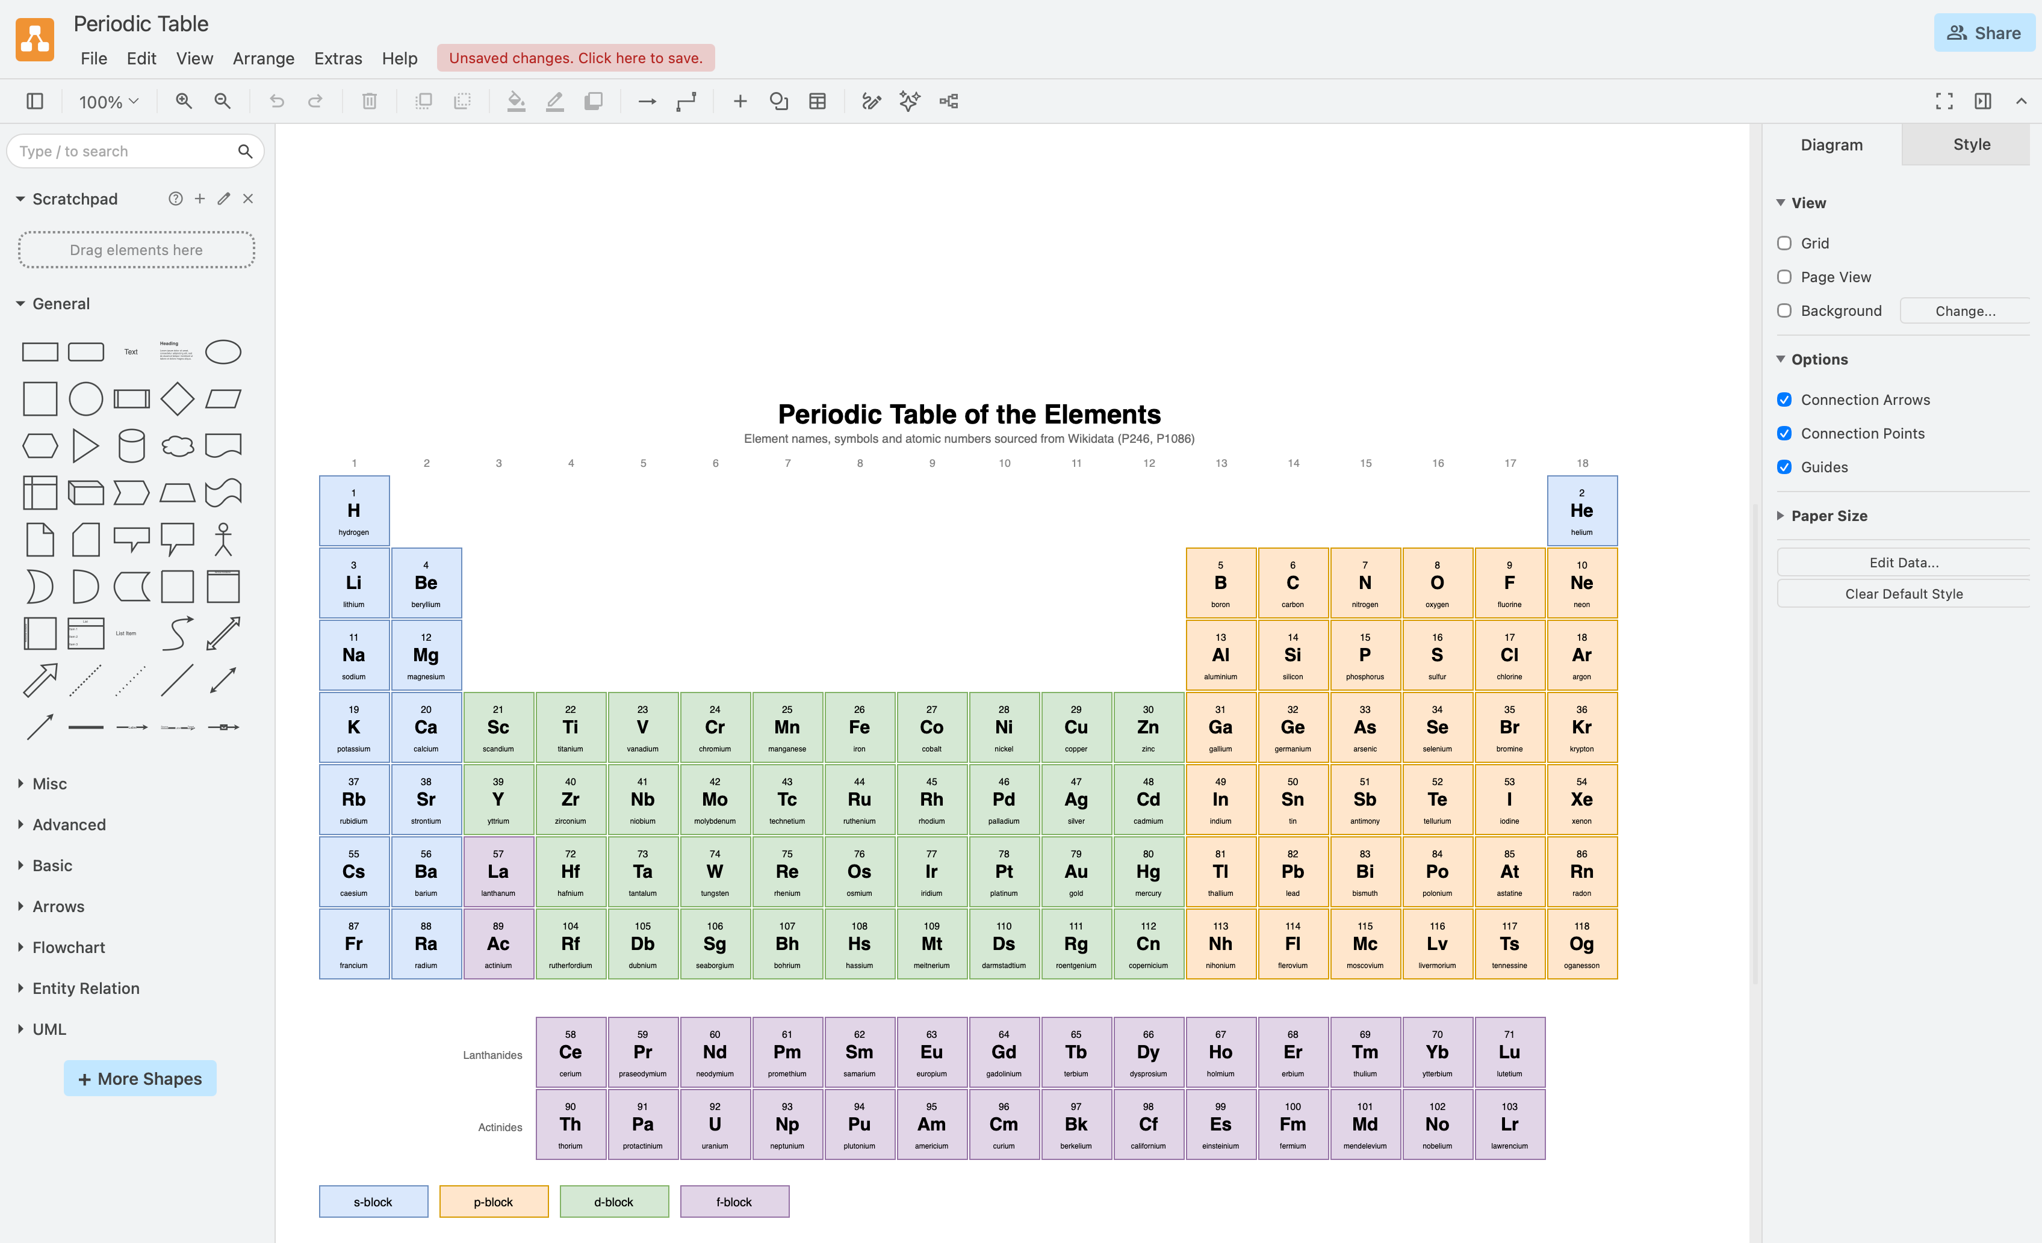
Draw.io and Wikidata

Slide 33
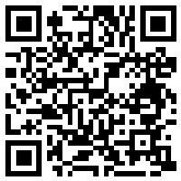
Activity
Things to try
Connect to an MCP server (if you haven’t already) and confirm access in a chat: “Do you have access to the [server name] MCP server?”
Ask what tools the server provides and how they work
Ask questions that use the tools and evaluate the quality of what comes back
For those who don’t want to sign in to claude.ai, there is a pre-baked conversation with tools you can follow.
Things to critique
Is the selection of tools provided by a given MCP server useful?
Is it clear which tools were used and why? What arguments were passed in and what response did the LLM get back?
Can you easily distinguish between a deterministic tool response and an LLM summary response?
Did the LLM give an accurate account of what the tool gave back?
What are some things that could go wrong with these kinds of Natural Language Interfaces to tools?
How would the LLM perform an equivalent task without access to specialised tools?
Workshop resources:
go.unimelb.edu.au/vh4h

Slide 34
Things to watch out for
Giving an LLM access to a tool does not make the entire interaction trustworthy. Use discretion.
There is a big difference between an LLM getting data from a tool and knowing what its significance is. Interpretation is often best left to humans.
Biases that flow through to tool use: selection or omission biases.
Security.
Always maintain a critical eye and be careful about common reasoning errors, both machine and human.

Slide 35
Questions?
daniel.russo@unimelb.edu.au

Slide 36
Handy MCP links
List of reference and third-party MCP servers, as well as MCP frameworks: https://github.com/modelcontextprotocol/servers
Official Python MCP SDK: https://github.com/modelcontextprotocol/python-sdk
FastMCP Framework (includes additional features): https://github.com/jlowin/fastmcp
TypeScript MCP SDK: https://github.com/modelcontextprotocol/typescript-sdk
“The Shift from Models to Compound AI Systems”: https://bair.berkeley.edu/blog/2024/02/18/compound-ai-systems/
LangGraph for compound AI systems:
  https://docs.langchain.com/oss/python/langgraph/thinking-in-langgraph
  https://docs.langchain.com/oss/python/langgraph/workflows-agents
RedHat post on security challenges: https://www.redhat.com/en/blog/model-context-protocol-mcp-understanding-security-risks-and-controls

